Slide 1
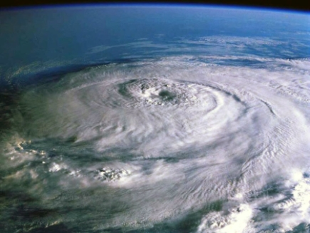
An introduction to mechanisms on the intensification and maintenance of Typhoons through the atmosphere-ocean interaction
Yoshiaki Miyamoto
Computational Climate Science Research Team
What is a typhoon
Researches on typhoons
Own studies
http://www.atmos.washington.edu/~houze/houze_files/hurricane.jpg

Slide 2
1. What is a typhoon?

Slide 3
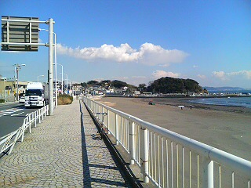
自己紹介
1983年5月2日 神奈川県鎌倉市生まれ
  学歴
    1996 4 – 1999 3 鎌倉市立腰越中学校
    1999 4 - 2002 3 慶應義塾高校
    2002 4 - 2006 3 慶應義塾大学理工学部
    2006 4 - 2008 3 京都大学理学研究科
    2008 3 - 2011 3 京都大学理学研究科
  職歴
    2008 4 - 2011 3 日本学術振興会 特別研究員（ＤＣ１）
    2011 4 - 理研AICS 特別研究員
    2008 9 - 2009 8 Center for Analysis and Prediction of Storms, The University of Oklahoma, Visiting Researcher
    2011 2 - 2011 3 National Center for Atmospheric Research, Visiting Scientist
趣味
  高校まで野球
  大学はダイビング（海）←2005年に山浦さんと久米島で会っていたｗ
  大学院は…大食いとか

Slide 4
The definition of a typhoon
Tropical cyclones generated on the tropical ocean, whose maximum wind speed exceeds 17 m s-1 (34 knot)
［Japan Meteorological Agency］
disc.sci.gsfc.nasa.gov

Slide 5
Height,
Inverse pressure
Temperature
Density

Slide 6
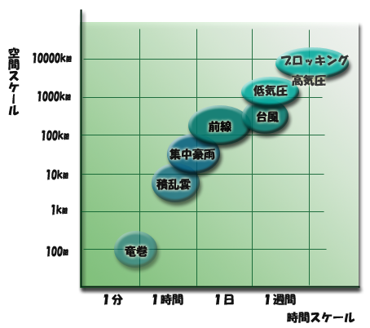
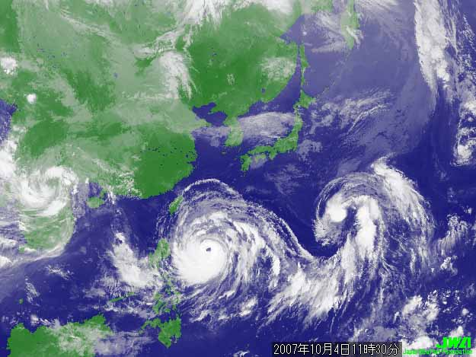
The definition of a typhoon
Why do people interest in typhoons?
・severe disasters
・difficulty of observation（danger）
・multi-scale interaction
http://www.jma.go.jp/jma/kishou/know/whitep/1-1-3.html
Atmospheric phenomena
in various both temporal and spatial scale
http://bobby.hkisl.net/mutteraway/?p=298

Slide 7
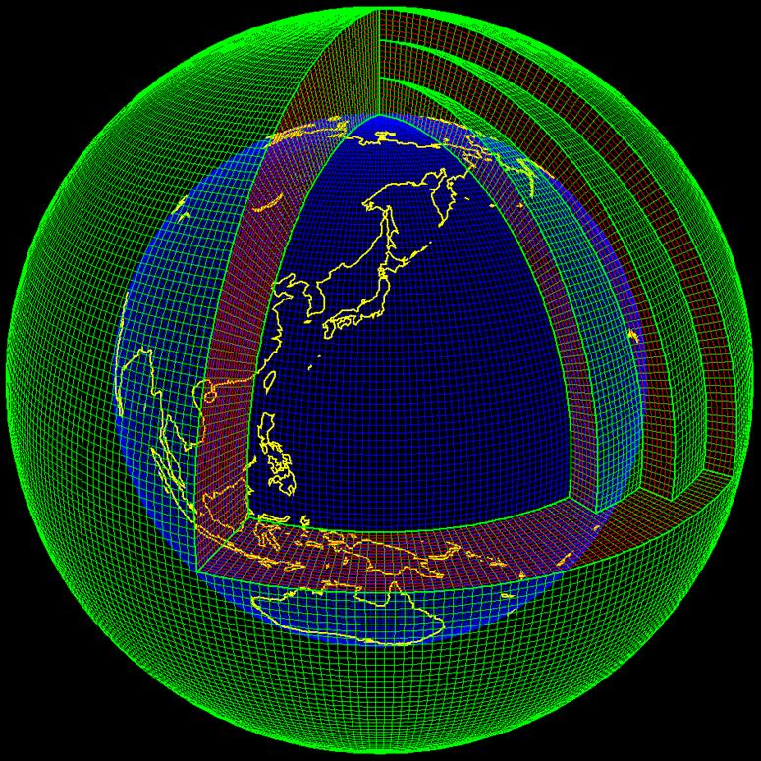
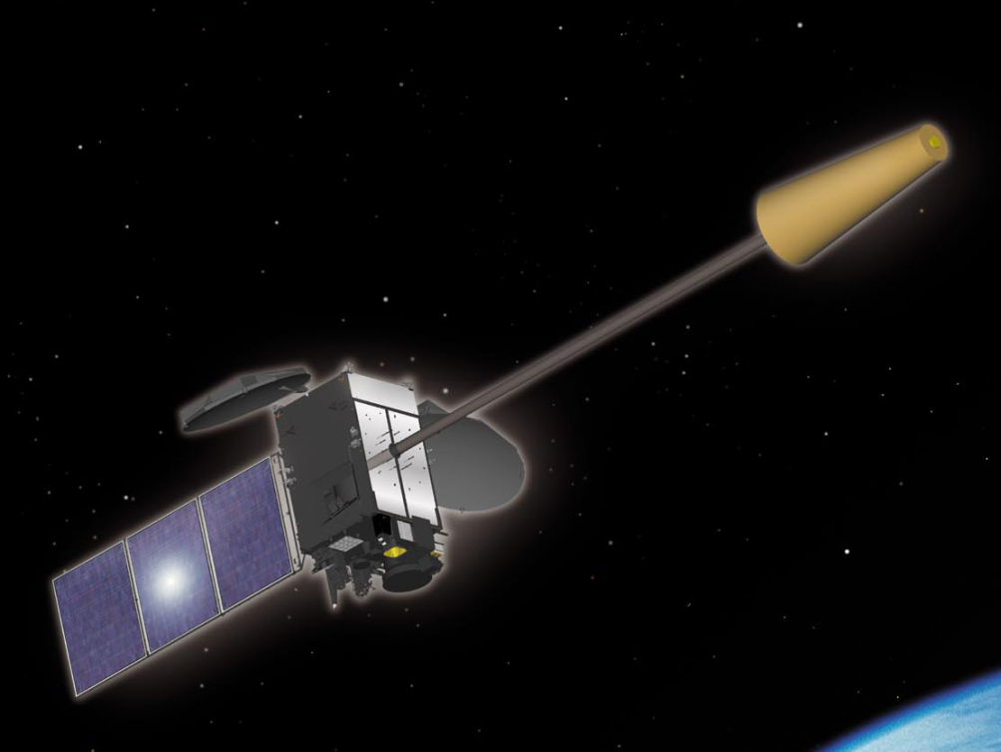
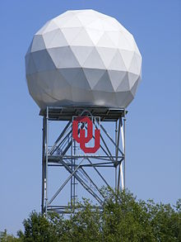
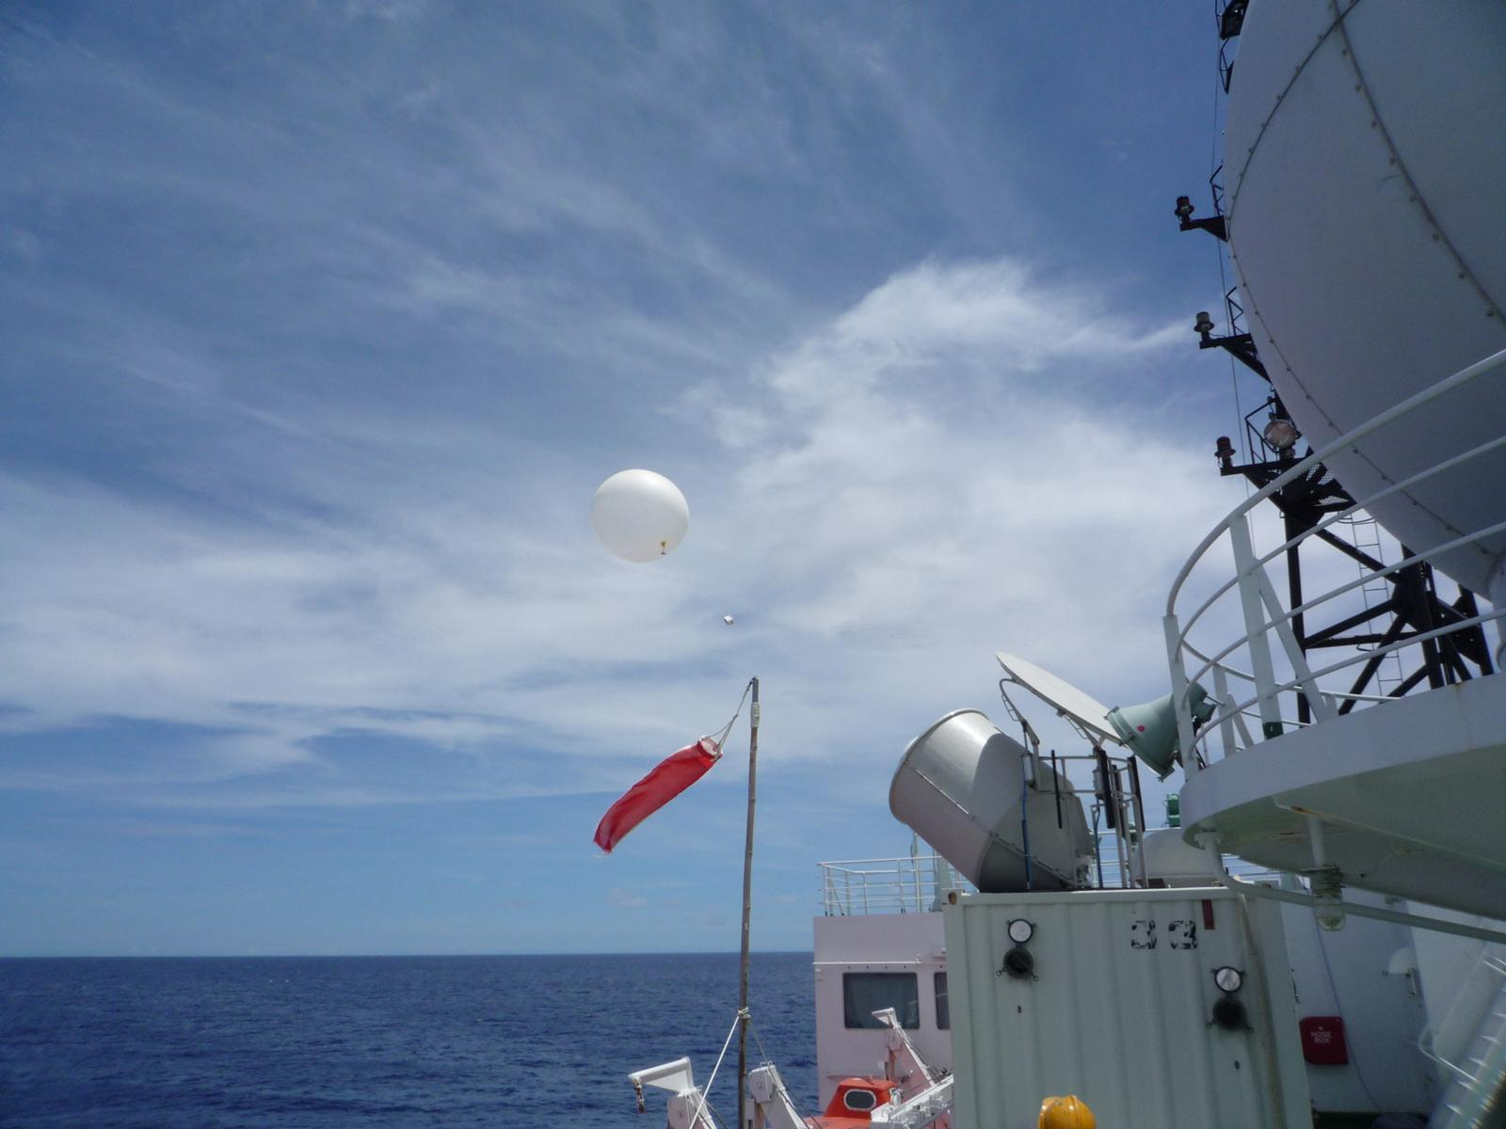
Weather Forecast
Past
Future
時間
Previous Prediction
Prediction
Numerical model
Data assimilation
Observational data
http://www.jma.go.jp/jma/jma-eng/satellite/
http://www.nicom-net.co.jp/seminar/2002.html
http://en.wikipedia.org/wiki/Weather_radar

Slide 8
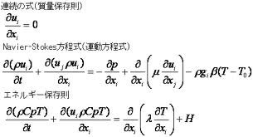
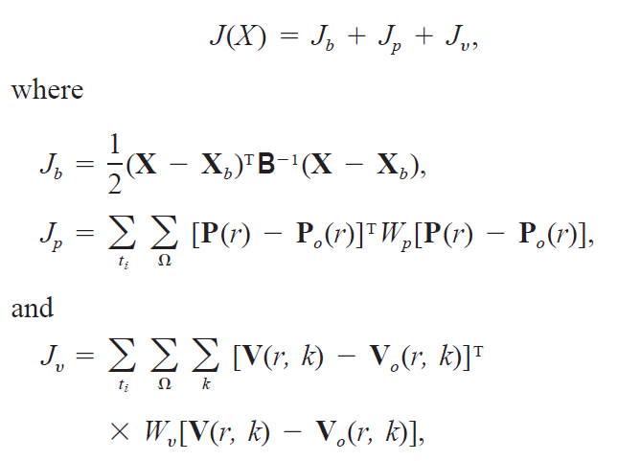


同化→予報
Past
Future
時間
Previous Prediction
Prediction
Numerical model
Data assimilation
sbdsupportweb.custhelp.com
Cost Function
true(t)＝observation(o)
background(b)=prediction(p)
水物質の保存式
Predicted results
＋
Observation
↓
Realistic, physically compatible field
各物理過程（○）
雲物理
放射
など…
where
: Error covariance matrix

Slide 9

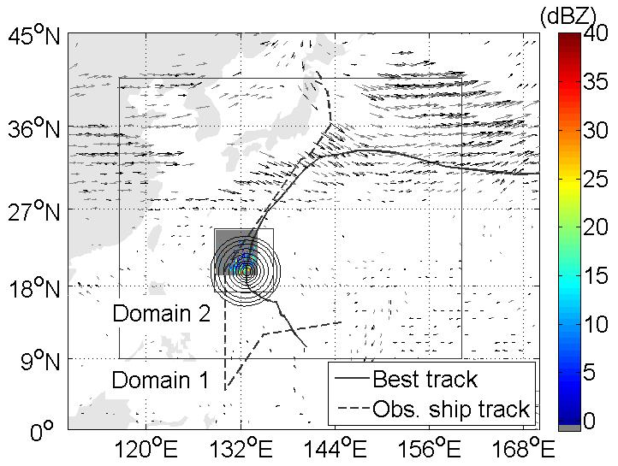
同化過程
Goal: minimize the cost function J
Initial guess
Observation
Background error
xb
yo
B
Optimization
xa
NWC method
(Parrish and Derber, 1992)
Boundary condition
Model calculation
Miyamoto and Xue (2009)

Slide 10
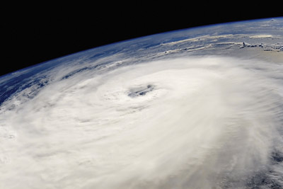
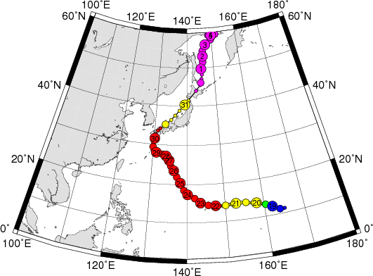
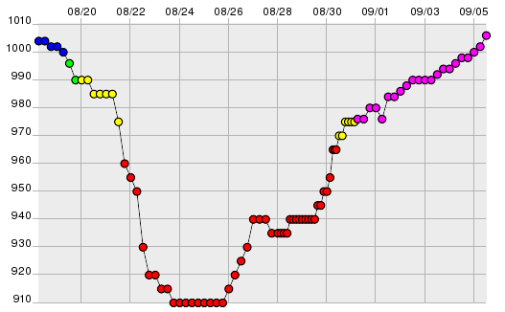
Life cycle
Intensity of a typhoon=
Maximum wind speed
Minimum surface pressure
developing：wind speed～30m s ⁻¹
time
Minimum
pressure
mature：wind speed～80m s ⁻¹
http://agora.ex.nii.ac.jp/digital-typhoon/summary/wnp/s/200416.html.ja

Slide 11
Motion
Background flow（e.g., Along the Pacific High）
Earth rotation（Beta drift）

Slide 12
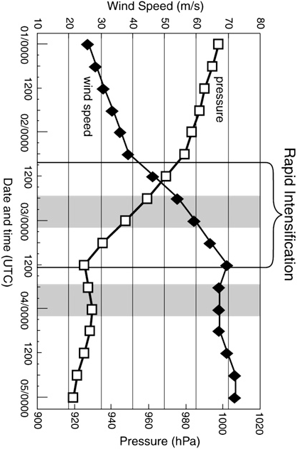
Life cycle
Max. wind speed（m s⁻¹）
Initial development
Genesis
風速
気圧
Development
（Rapid Intensification phase)
time→
Steady state
http://www.taxfoundation.org/blog/show/24716.html
Dissipating phase
Sitkowski and Barnes (2010)
Min. pressure（hPa）

Slide 13
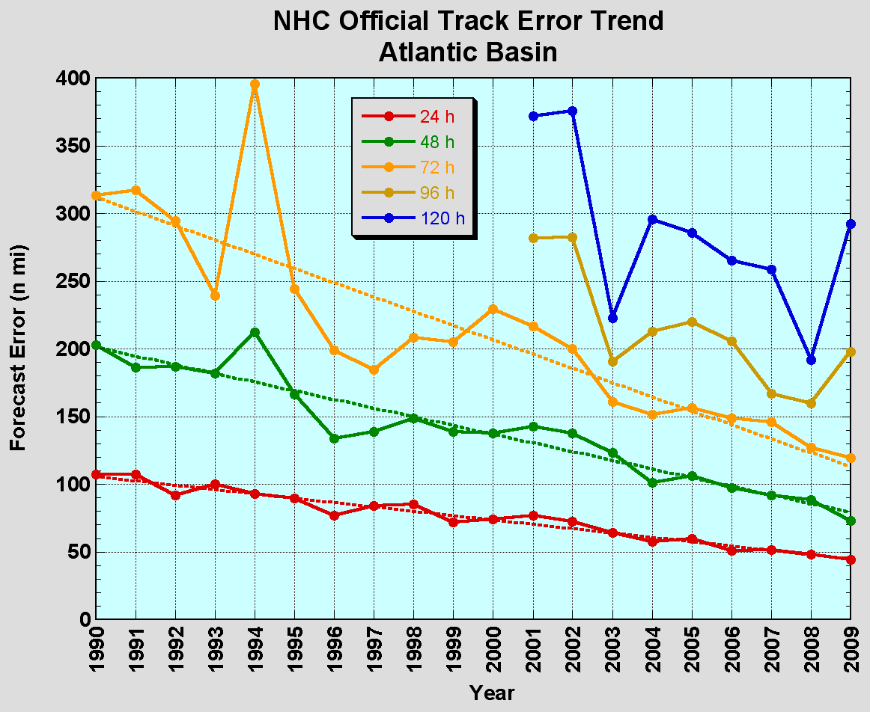
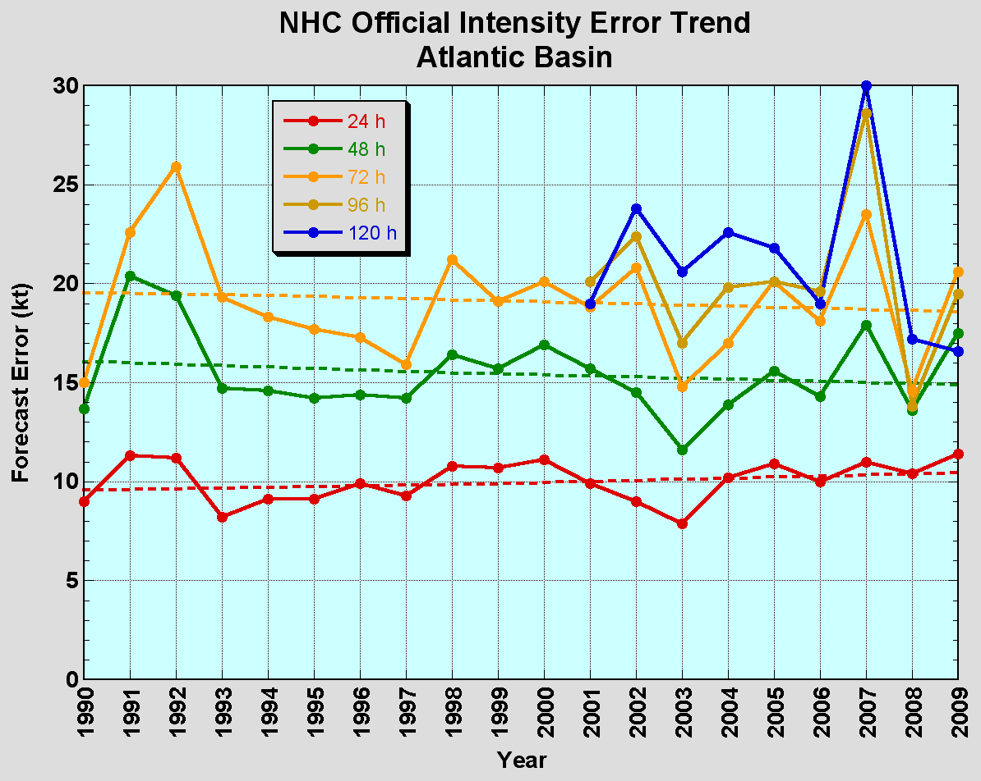
Forecast skill of the track and intensity of typhoons
There is no improvement on the intensity（⇔track getting better）
track
intensity
Error of track forecast
Error of intensity forecast
Annual change in typhoon Forecast
NHC annual report 2009
Despite of the significant progress in computer power and models, the error does not decrease
⇒Models do not capture key physical phenomena
So what?
∴Motivation:
to improve understanding of what happens in a typhoon

Slide 14
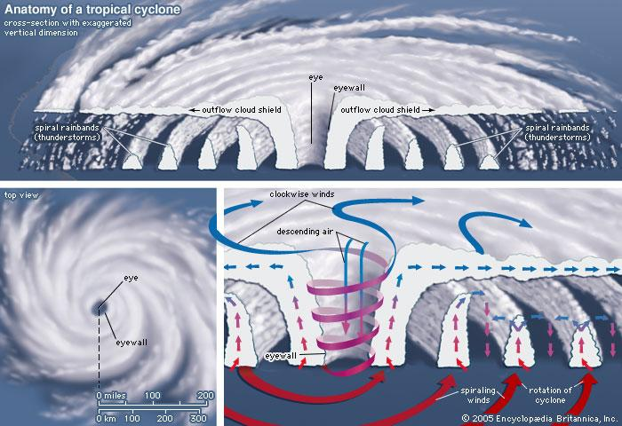
Structure
symonsez.wordpress.com

Slide 15
Flow field
中心で気圧最少＝気圧傾度は半径方向に正勾配
回転→遠心力
場の回転＝コリオリ力
この流体粒子が内側に入っていけば（気圧傾度力が他の力を上回るor他の力によって内向き加速度が与えられれば）、角運動量保存によって渦は強化される

Slide 16
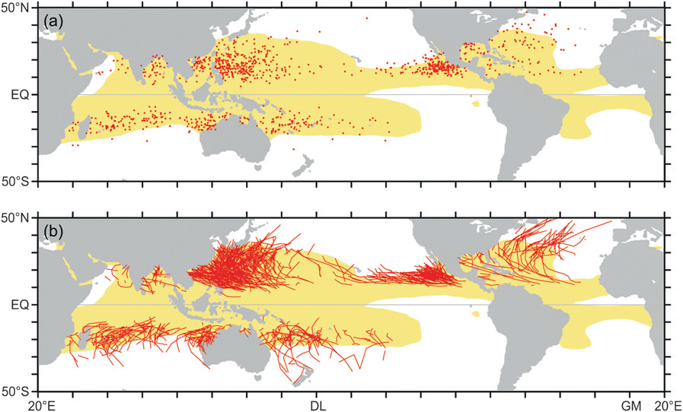
Favorable environment for typhoon genesis (Gray 1975, 1979)
Houze (2010)
High the Coriolis parameter
High low-level relative vorticity
Low tropospheric vertical wind shear
High sea surface temperature
Convectively unstable
High relative humidity in the mid-troposphere

Slide 17




Intensification theory (Ooyama 1963; Charney and Eliassen 1964)
水蒸気の凝結
→空気塊を加熱
温かい＝軽い
空気塊→上昇

Slide 18
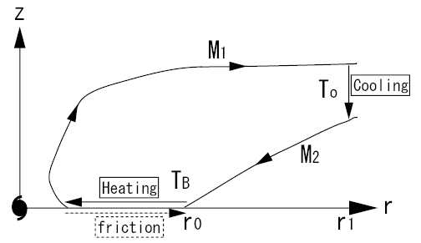
Maximum Potential Intensity of a typhoon
Emanuel (1986): mature typhoon〜 Carnot heat engine
Energy : thermodynamic energy from the ocean
Work ： Dynamic energy transport to the ocean
Thermal efficiency
height
Emanuel’s Theory
radius
※異なる導出方法もある

Slide 19
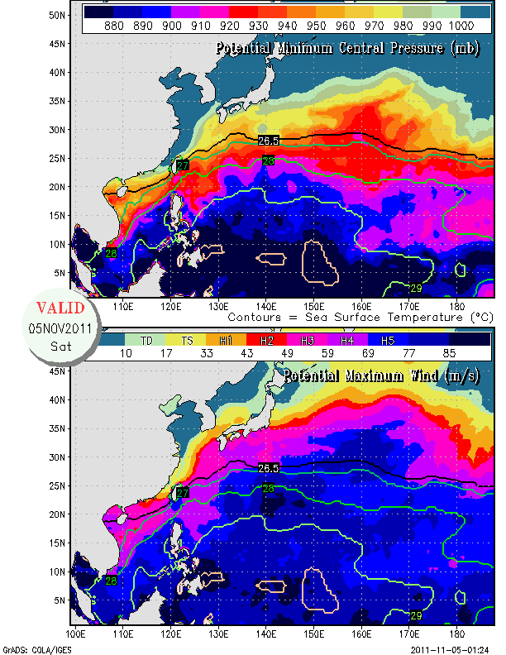
Maximum Potential Intensity of a typhoon
Temperature difference between the sea surface and the upper troposphere
Ratio of exchange coefficients
Enthalpy difference between the atmosphere and the ocean
height
Emanuel’s Theory
radius
http://wxmaps.org/pix/hurpot.html

Slide 20
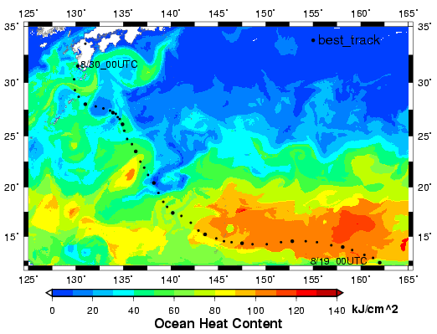
Energy supply from the ocean
If thermodynamic energy keeps transferring to the atmosphere, TC can develop to its maximum intensity
No thermodynamic energy No typhoon (landfall makes a typhoon weak）
http://agora.ex.nii.ac.jp/digital-typhoon/summary/wnp/s/200416.html.ja

Slide 21
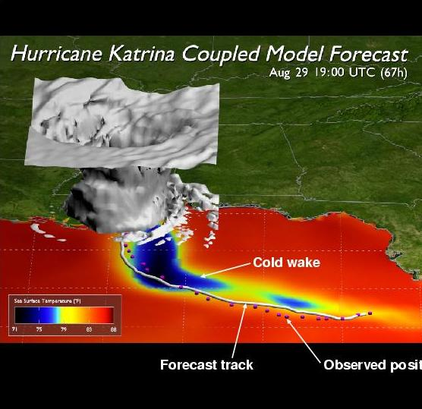
Sea surface cooling due to the ocean mixing 1/2
Air-sea interaction under a typhoon
Momentum transport to the ocean
In the RHS of a typhoon (危険半円), the mixing is significant.
Mixing between the warm and cold water
→temperature at the ocean surface decreases.

Slide 22
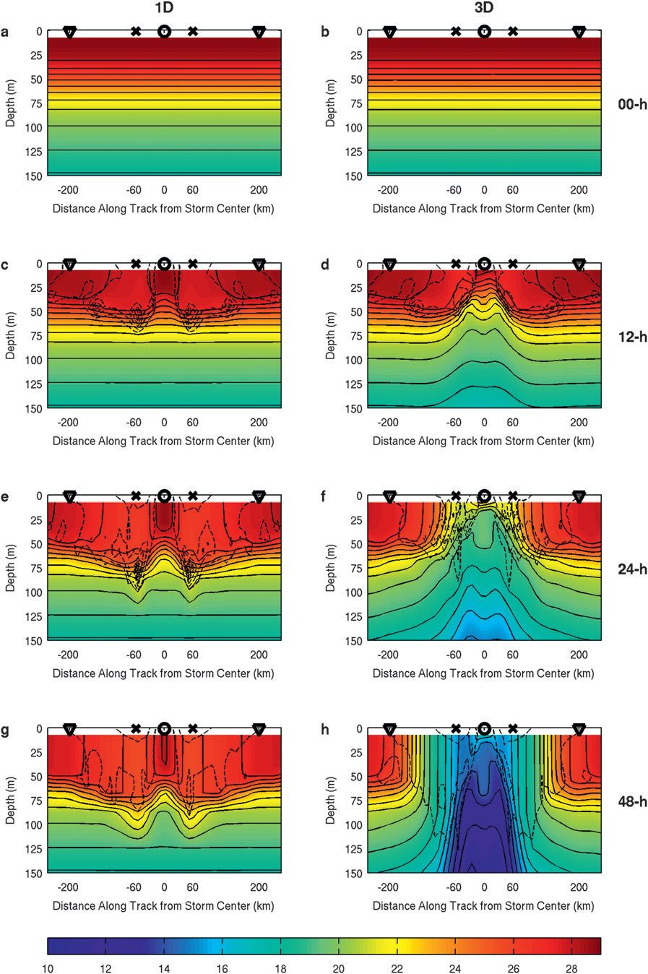
Sea surface cooling due to the ocean mixing 2/2
Yablonsky and Ginis (2009)

Slide 23
Summary１（What is a typhoon?）
Typhoon is a very intense and severe atmospheric vortex and its energy source is oceanic thermodynamic energy.
Typhoon Intensifies through the atmosphere-ocean interaction.
Typhoon has a maximum achievable intensity.
Forecast on Typhoon intensity has not been improved in this two decades.
Intensification mechanism
Convergence by vortex rotating in the counter-clockwise direction （in the northern hemisphere）.
Well-moistened air arises around the rotation center
Condensation accelerates the upward motion
Rotation intensifies（go to ①）
③
④
②
①

Slide 24
2. Researches on TYphoons

Slide 25

Approaches of typhoon studies
Observational
http://www.jma.go.jp/jma/jma-eng/satellite/
http://en.wikipedia.org/wiki/Weather_radar
Data assimilation
Suggestions for new observation
Confirmation of proposed theories and findings of observations
modeling
Theoretical
Verification of theories
Interpolation of numerical results by theories
http://www.google.com/imgres?hl=ja&sa=X&rlz=1T4MOCJ_ja
http://www.nicom-net.co.jp/seminar/2002.html

Slide 26
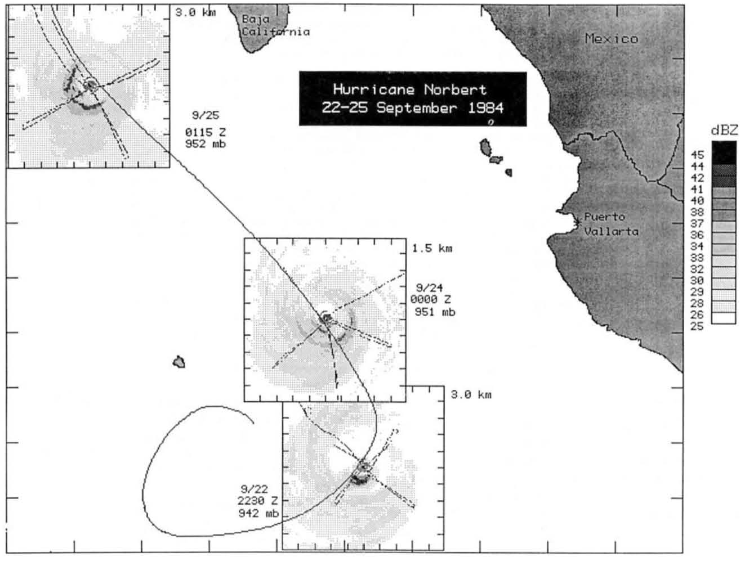
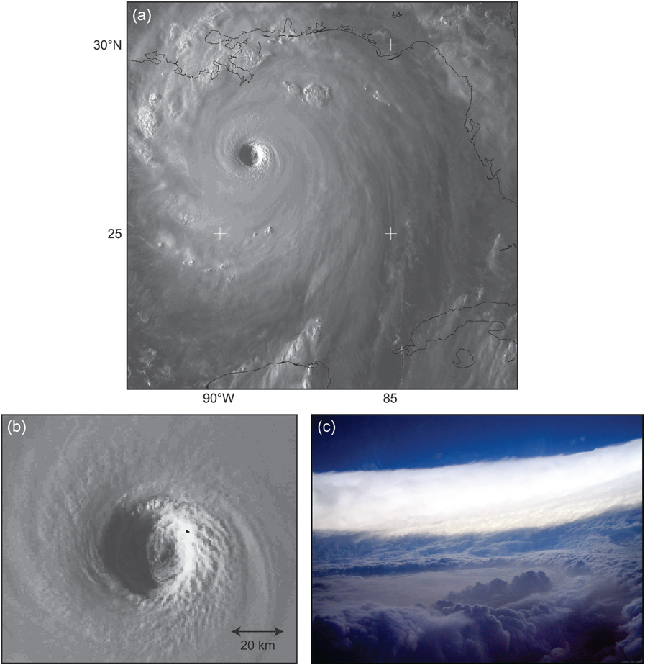
Observations 1/3
Remote
Radar
Satellite
Direct
in-situ
Airplanes
Ships
Obs. station (Radio Sonde)
Houze (2010)
Marks et al. (1992)

Slide 27
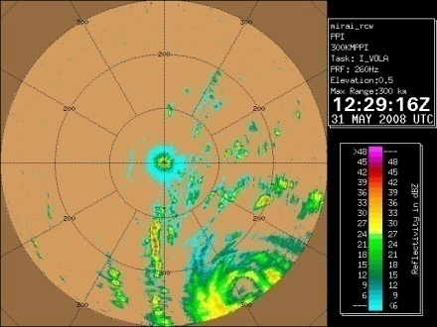
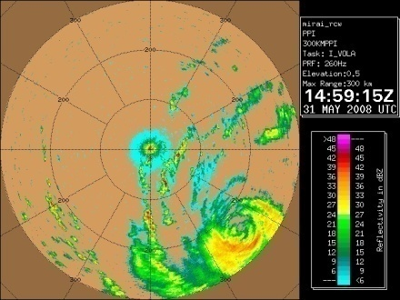
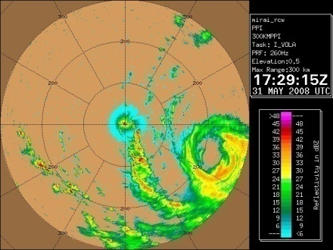
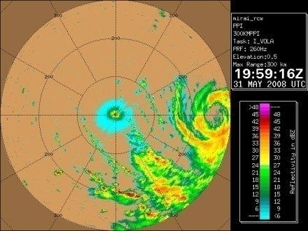
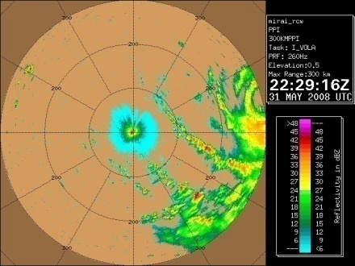
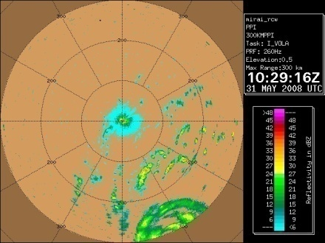
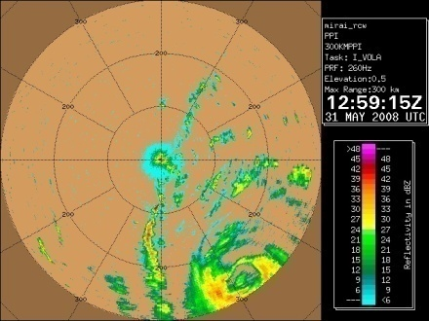
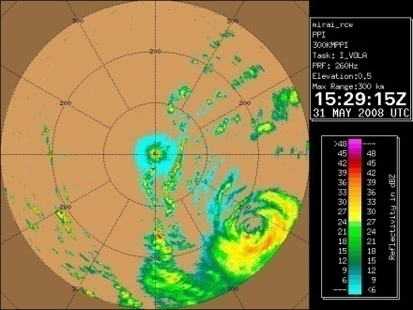
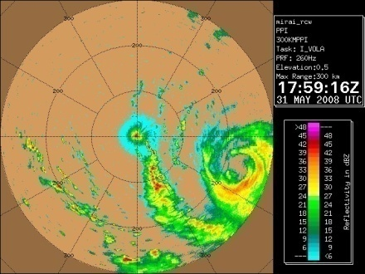
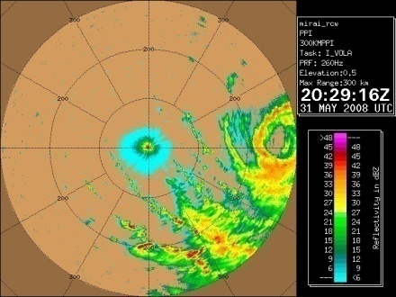
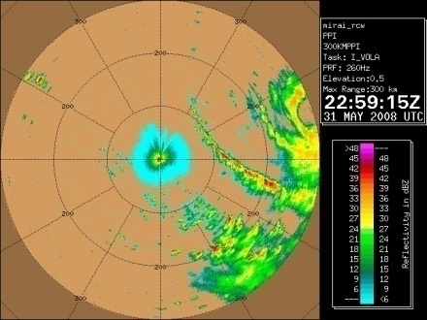
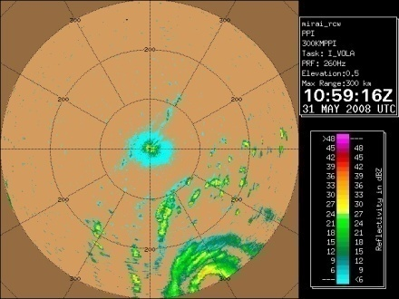
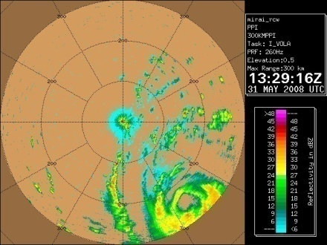
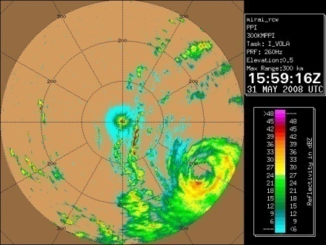
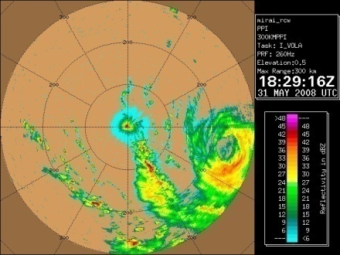
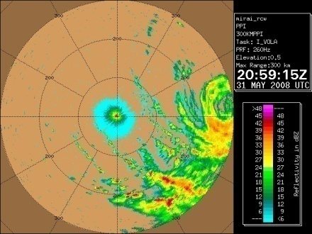
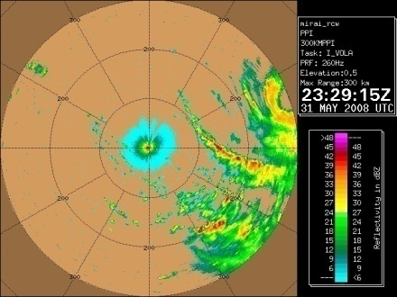
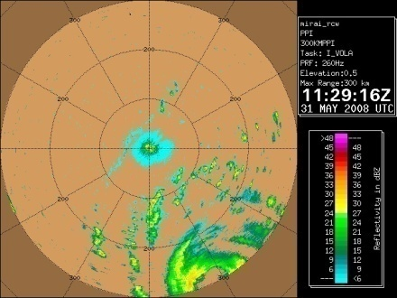
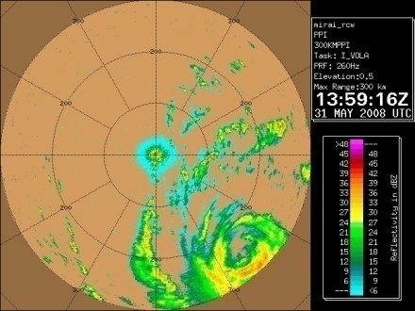
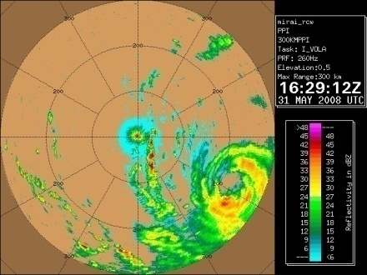
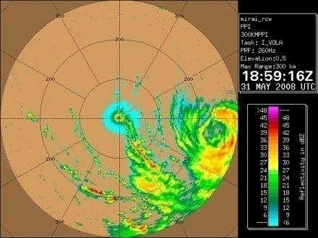
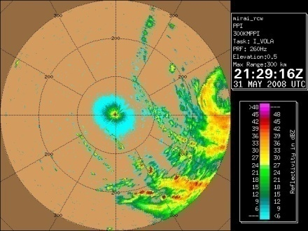
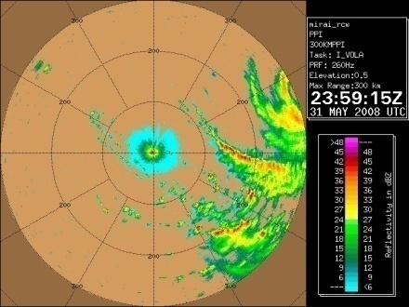
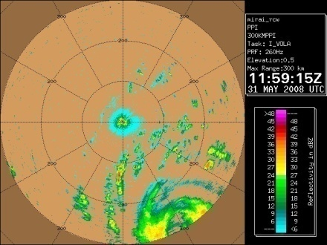





Observations 2/3

Slide 28

Observations 3/3
Houze (2010)

Slide 29




Typhoons simulated by numerical models 1/4
Ooyama (1969)
Δx = 5 km
Ideal ※2D
Kurihara and Tuleya (1974)
Δx = 20 km
Ideal
Kurihara et al. (1990)
Δx = 18 km
Real
Braun (2006) Δx = 2 km
Real

Slide 30

Typhoons simulated by numerical models 2/4
Ertel’s Potential Vorticity（PV）
Model | WRF
Domain | 3000×3000 km²
Horizontal reso | 2 km
Cloud physics | Warm rain
Turbulence | Smagorinsky
Radiation | --
Sea temperature | 300 K
Colioris Parameter | 5*10⁻⁵ s⁻¹
Initial sounding | Jordan (1958)
PV>0
PV<0
Interval: 2 PVU
Intensity
Miyamoto and Takemi (2011, in revision)

Slide 31

Typhoons simulated by numerical models 3/4
Model | NICAM
Domain | global
Horizontal reso | 7 km
Cloud physics | Tomita (2008)
Turbulence | Noda et al. (2010)
Radiation | Sekiguchi and Nakajima (2008)
Sea temperature | Reynolds SST
Tangential wind/v_{m}
Radial wind/v_{m}
height
高度
radius
radius
Miyamoto et al. (2011, in preparation)

Slide 32
Typhoons simulated by numerical models 4/4
Emanuel (2007)
Holland and Webster (2007)
Positive correlation between the sea surface temperature and intensity of typhoons
Increasing trend especially in the late of 20th century
Webster et al. (2007)

Slide 33

Theoretical (numerical) studies 1/2
Montgomery and Kallenbach (1997)
Schubert et al. (1999)
http://www.hurricanescience.org/science/science/hurricanestructure/
The “eye” is not always circular and the shape may be determined by fluid dynamical processes.
Notes:
dynamical processes

Slide 34
Theoretical (numerical) studies 2/2
Schecter and Dunkerton (2009)
Typhoons can be generated without any precursor.

Slide 35
Summary ２（researches on typhoons）
Many numerical studies due to the difficulty of observation and nonlinearlity
Scientific target shifts from track（~1990） to small scale phenomena in the core region
As models gain in popularity, number of “case study” is on the increase
Recent climatological studies focus on future changes (global warming)
Unsolved problems = genesis/intensification processes (especially genesis, how a typhoon generates, what is the mechanism)

Slide 36
3. Own studies
Effective radius for sea surface fluxes
(Miyamoto and Takemi 2010)
Maximum intensity theory including the effect of ocean mixing
(Miyamoto, Bryan and Rotunno 2011, in prep.)

Slide 37
Intensification theory (Ooyama 1963; Charney and Eliassen 1964)
水蒸気の凝結
→空気塊を加熱
温かい＝軽い
空気塊→上昇

Slide 38

Hypothesis：Effective radius
Effective Radius for TC intensity：enthalpy fluxes within which fluxes play positive role on TC intensity
＝beyond the radius enthalpy fluxes do not effect on TC intensity positively
A schematic figure of steady state TC structure (Smith et al., 2008).
Objective：to reveal the existence of effective radius and understanding the physical meaning

Slide 39

Axisymmetric Typhoon Model (ATM)
Time descretization | 3rd order Runge-Kutta
advection | 5th-order accuracy and positive-definite scalar advection
condensation | Saturation adjustment
microphysics | Kessler (1969) warm rain
turbulence | Smagorinsky-type Eddy viscosity
radiation | Newton cooling
Gravity wave | Rayleigh damping layer
Based on
Bryan and Rotunno (2009)

Slide 40




Axisymmetric Typhoon Model (ATM)
Momentum for three dimension (radial, tangential and vertcal)
Mass of fluid
thermodynamic energy, water vapor and liquid water

Slide 41


Numerical experiments（experimental setting）
Coriolis parameter | 5×10⁻⁵ s⁻¹
Sea Surface Temperature | 300 K
Domain (radial × vertical) | 1500×25 km
Radial grid distance (min/max) | 1 / 21 km
vertical grid distance (min/max) | 250 / 1500 m
Integration time | 150 h
Initial sounding | Jordan (1958)
Surface exchange coefficients for momentum/enthalpy | Donelan et al. (2004)/ Zhang et al. (2008)
41

Slide 42



Control run
TC develops up to t=110 h and maintains its intensity.
Qualitatively, steady state TC structure is well resolved.
フラック

Slide 43
Sensitivity experiments
Each experiment starts at t=120h of the control run and is carried out by cutting off enthalpy fluxes beyond a radius (r_{exp}).
rexp (km) | Exp. name | rexp (km) | Exp. name
------ | ctl | 120 | r120
0 | r0 | 150 | r150
10 | r10 | 200 | r200
20 | r20 | 300 | r300
30 | r30 | 500 | r500
40 | r40 | 1000 | r1000
50 | r50
60 | r60
70 | r70
80 | r80
90 | r90
100 | r100
Ck
rexp
r
: flux area (calculated as usual)
: No enthalpy flux area

Slide 44
Sensitivity experiments（results）
The impact of Exps. In which the fluxes are cut off beyond the 90-km or 100-km radii. →The effective radius in this Exp. 〜100km.

Slide 45
Correlation between TC intensity and area-integrated enthalpy flux
Using the result of the control run, correlation coefficients between the fluctuation of TC intensity from t=120 to 150h and area-integrated enthalpy flux up to a radius are calculated.
r
: calculated area
: not included in the integration
120h
150h
t
Correlation coefficient

Slide 46
Correlation coefficients
A peak exists around 100-km radius

Slide 47
Discussion 1/2
・enthalpy conservation equation in the inflow layer
・mass conservation
⇒
―integrate in the inflow layer
―enthalpy from the ocean is transported to the TC core
・the profile of ru in a developed TC has a strong positive gradient outside the negative peak and becomes 0 at the infinite radius
=there must be a radius beyond which the gradient of ru becomes small (= enthalpy balances in the vertical direction locally)
⇒Isn’t this the effective radius?
A
B

Slide 48
Discussion 2/2
Actually the radial flux divergence term has nonzero value
up to 100-km radius

Slide 49

Conclusion
The numerical experiments revealed there is an effective radius in a developed TC
In this experiment, the radius locates around the 100-km radius.
The results indicate that the effective radius can be interpreted as the point where the radial gradient of ru becomes small.

Slide 50
Possible Application ①
陸に接近したTCが、どの程度離れたところから（直接）強度に影響が出て来るのか分かる
例えば陸地に並走するTCでも、有効半径より外側に陸が位置していれば強度に直接的な影響はない

Slide 51
Possible Application ②
Mesoscale vortices in the ocean are very common
Fluctuation of temperature inside the effective radius changes typhoon intensity
Track forecast is fairly good
⇒Combining with track forecast, the effective radius can be a good indicator.

Slide 52
Summary
The biggest motivation to study typhoons is to improve daily forecasts
Important factors which should be predicted well
  Track
  Intensity
  Size
Hot topics
  Changes of typhoons in this and next century
  Genesis mechanism
For the two topics, a global circulation model such as NICAM will probably be an useful tool

Slide 53

これを読んで下さい
たいふうの本
一家（チーム）に一冊！
http://www.google.com/imgres?hl=ja&rlz=1T4MOCJ_ja___JP425&biw=1086&bih=554&tbm=isch&tbnid=o-LFU64xrDZltM:&imgrefurl

Slide 54
Acknowledgement
本研究は日本学術振興会・京都大学防災研究所「組織的な若手研究者派遣」の支援による第一著者のNCAR滞在時（2011/2/22〜2011/3/18）に行われました。
本研究は日本学術振興会科学技術研究費20-776の支援を受けて行われました。
渡航に関して竹見先生（京大）に大変お世話になりました。
沢田先生（東北大）、石川先生（京大）、吉田くん（理研）と議論していただきました。

Slide 55

これまでの研究活動
2006年3月
2008年3月
2008年6月
2008年9月
～
2009年9月
2009年10月
～
2011年1月
卒論：熱的不安定によって生じるロールセル対流場の温度計測（機械工学）
修論：強風下の海面粗度変化による熱帯低気圧の強度への影響に関する数値的研究（Miyamoto and Takemi 2011a, in press）
みらい（MR0802）乗船
大気ー海洋ー波浪モデル構築
米国オクラホマ:
ボーガスデータ同化による熱帯低気圧計算初期値作成
（Miyamoto and Xue 2009 Int. Symp. on Radar and Modeling studies）
軸対称非静力学モデル構築（Miyamoto and Takemi 2011c in preparation）
Sea Sprayモデル構築
海面エンタルピーフラックス有効半径
（Miyamoto and Takemi 2010）
発達する熱帯低気圧の海面フラックス依存性
（Miyamoto and Takemi 2011c, in preparation）
急発達過程への遷移メカニズム
（Miyamoto and Takemi 2011b, revised）
博論：熱帯低気圧の強化・維持過程における海面フラックスの役割

Slide 56
Typhoons simulated by numerical models 4/4
Growth rate of a typhoon
Rate of transportation of thermodynamic energy

