Slide 1
Special-purpose computers for scientific simulations
Makoto Taiji
Processor Research Team
RIKEN Advanced Institute for Computational Science
Computational Biology Research Core
RIKEN Quantitative Biology Center
taiji@riken.jp

Slide 2
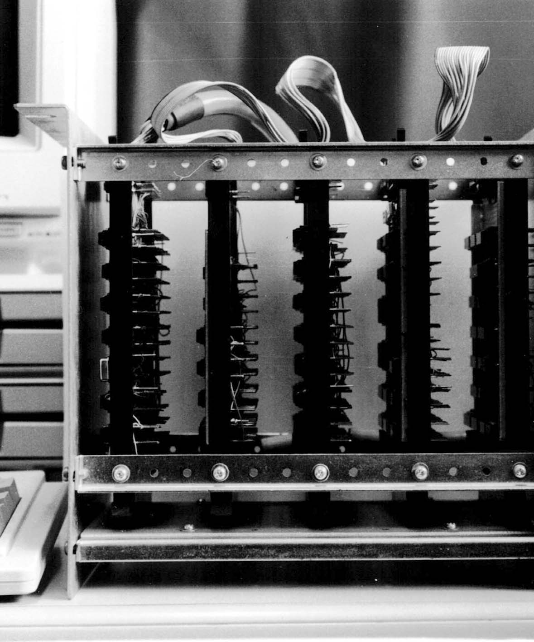
Accelerators for Scientific Simulations(1):
Ising Machines
Ising Machines
Delft/ Santa Barbara/
Bell Lab.
Classical spin = a few bits: simple hardware
m-TIS (Taiji, Ito, Suzuki):
the first accelerator that coupled tightly with the host computer.
m-TIS I (1987)

Slide 3
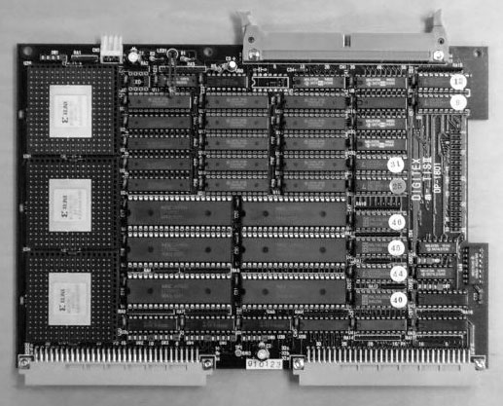
Accelerators for Scientific Simulations(2):
FPGA-based Systems
Splash
m-TIS II
Edinburgh
Heidelberg

Slide 4
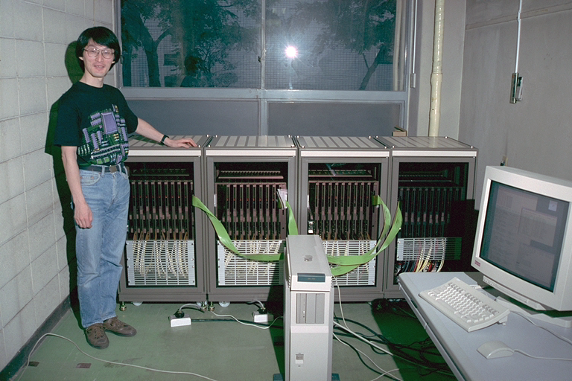
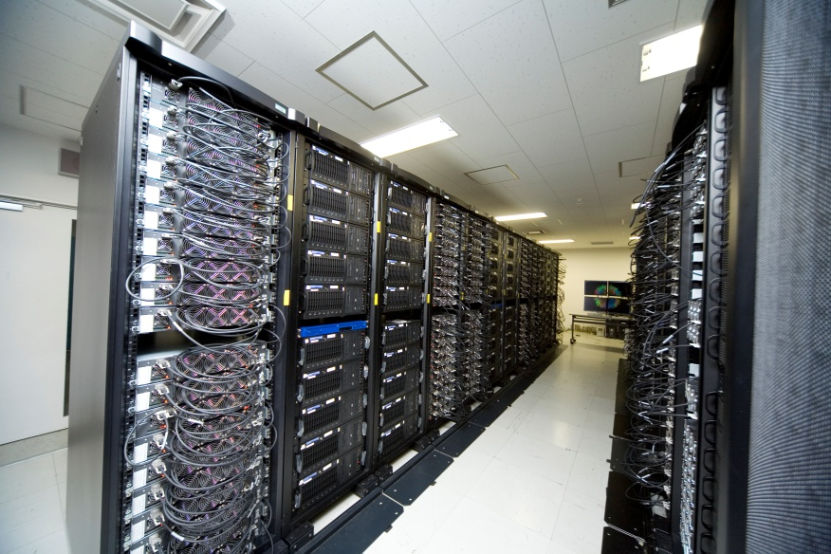
Accelerators for Scientific Simulations(3):
GRAPE Systems
GRAvity PipE: Accelerators for particle simulations
Originally proposed by Prof. Chikada, NAOJ.
Recently D. E. Shaw group developed Anton,
highly-optimized system for particle simulations
GRAPE-4 (1995)
MDGRAPE-3 (2006)

Slide 5
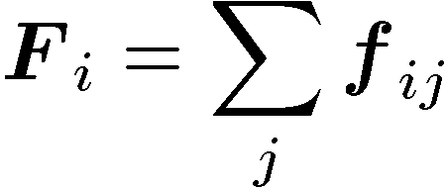
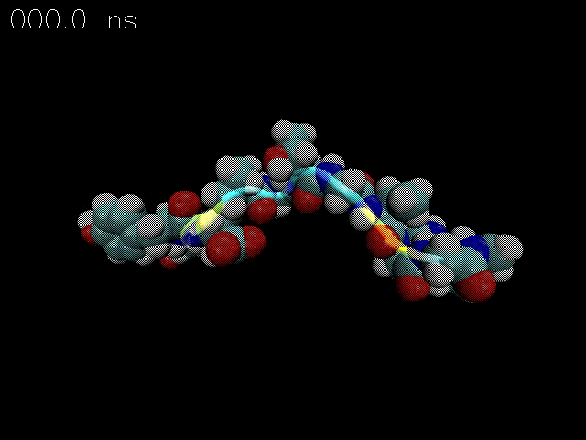
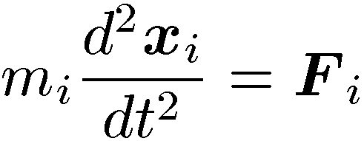
Classical Molecular Dynamics Simulations
Force calculation based on
“Force field”
Integrate Newton’s
Equation of motion
Evaluate physical quantities
+
-
Coulomb
Bonding
van der Waals

Slide 6
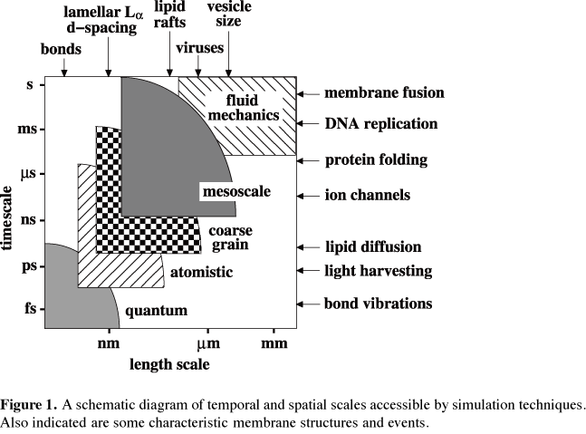
Challenges in Molecular Dynamics simulations of biomolecules
Strong
Scaling
Femtosecond to
millisecond
difference
=10¹²
Weak Scaling
S. O. Nielsen, et al, J. Phys. (Condens. Matter.), 15 (2004) R481

Slide 7
Scaling challenges in MD
〜50,000 FLOP/particle/step
Typical system size : N=10⁵
5 GFLOP/step
5TFLOPS effective performance
1msec/step = 170nsec/day
Rather Easy
5PFLOPS effective performance
1μsec/step = 200μsec/day???
Difficult, but important

Slide 8
What is GRAPE?
GRAvity PipE
Special-purpose accelerator for classical particle simulations
  Astrophysical N-body simulations
  Molecular Dynamics Simulations
J. Makino & M. Taiji, Scientific Simulations with Special-Purpose Computers,
John Wiley & Sons, 1997.

Slide 9
History of GRAPE computers
Eight Gordon Bell Prizes
  `95, `96, `99, `00 (double), `01, `03, `06
Notes:
This shows the history of GRAPE systems. Red line shows the machines for molecular dynamics. MDM developed in RIKEN at 2000 has 78 Tflops performance and it still stands as the fastest nominal peak-performance machine. Blue and magenta line denotes the machines for astrophysics, while magenta line is machines with low-precision arithmetics. Simulations with GRAPE systems won seven Gordon Bell prizes in total.

Slide 10
GRAPE as Accelerator
Accelerator to calculate forces
by dedicated pipelines
Host
Computer
Particle Data
GRAPE
Results
Most of Calculation → GRAPE
Others → Host computer
Communication = O (N) << Calculation = O (N²)
Easy to build, Easy to use
Cost Effective

Slide 11
GRAPE in 1990s
GRAPE-4(1995): The first Teraflops machine
Host CPU
~ 0.6 Gflops
Accelerator PU
~ 0.6 Gflops
Host:
Single or SMP
Scientist & Architect
Accelerator
Host

Slide 12
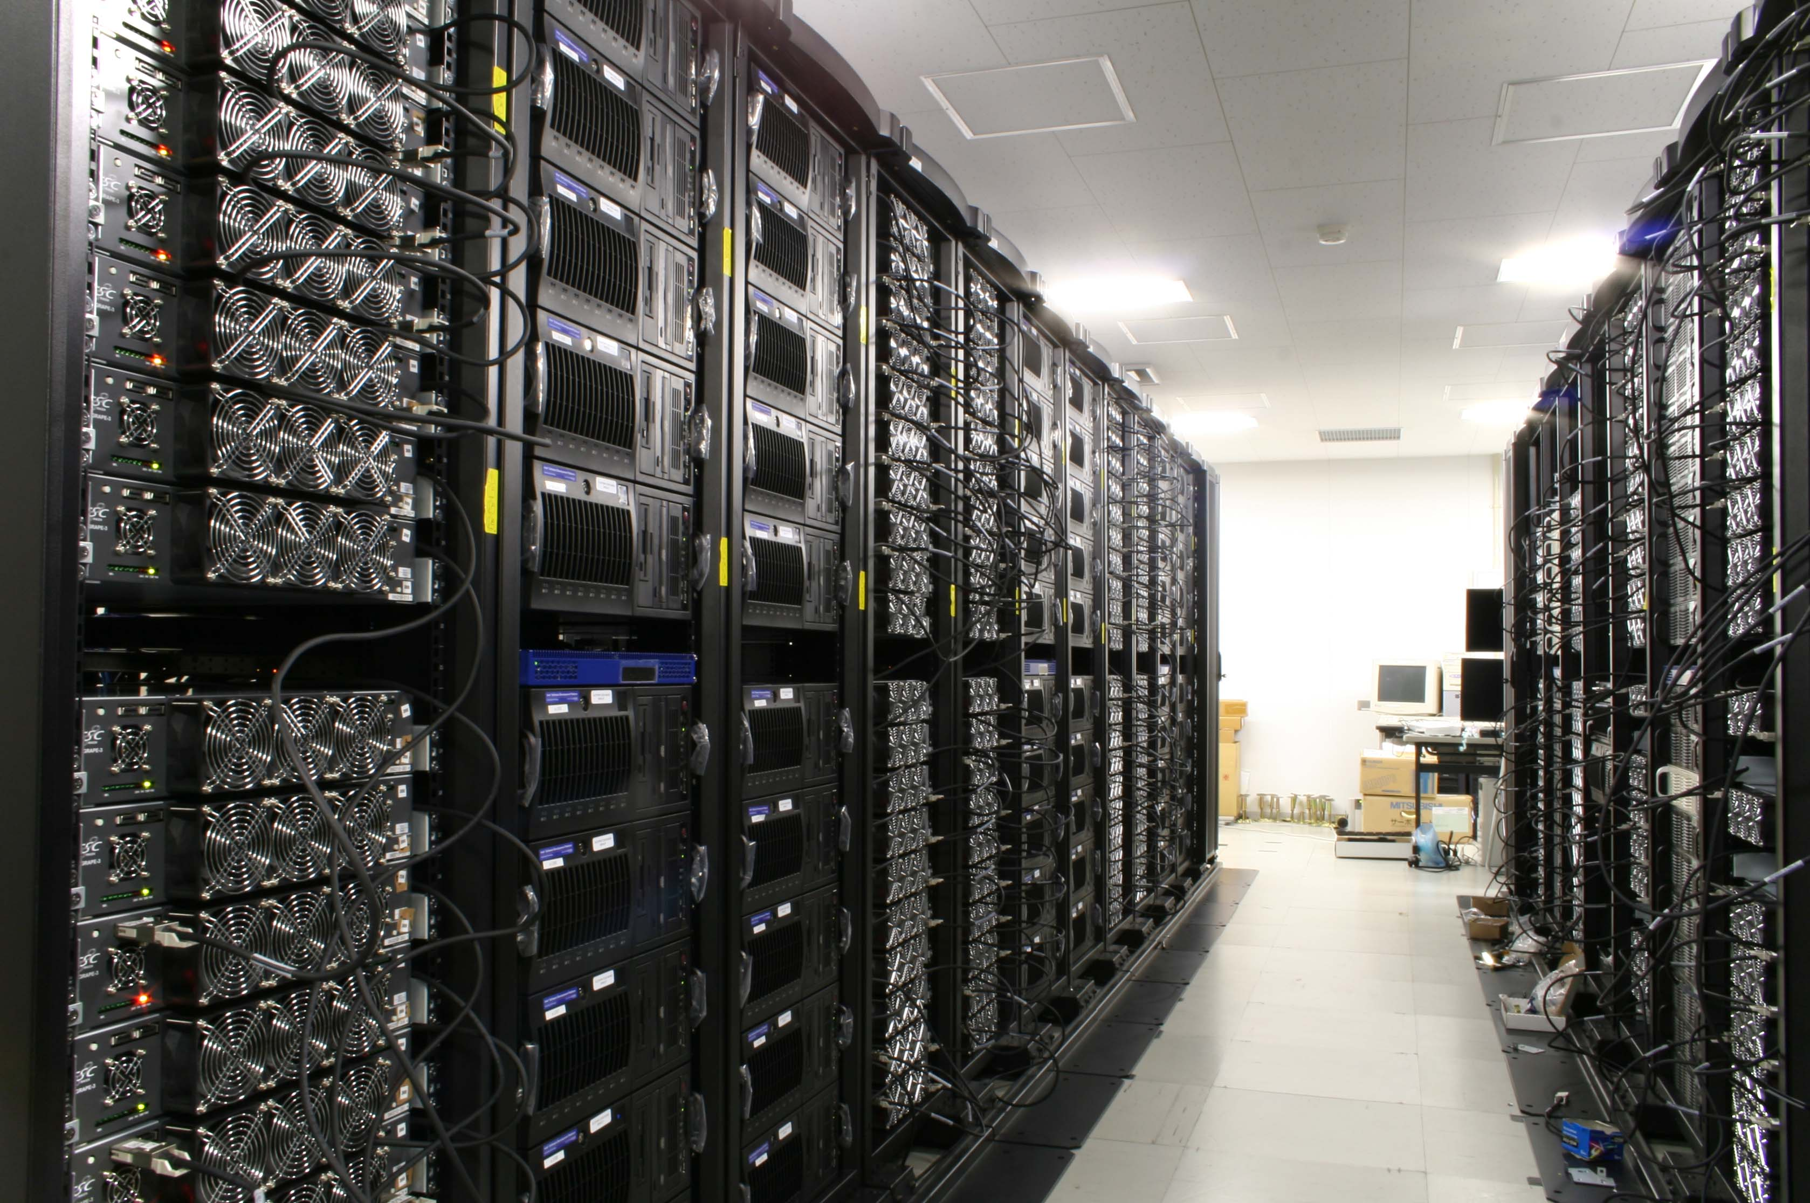
GRAPE in 2000s
MDGRAPE-3: The first petaflops machine
Host CPU
~ 20 Gflops
Accelerator PU
~ 200 Gflops
Host:
Cluster
Accelerator
Host
Scientists not shown but exist

Slide 13
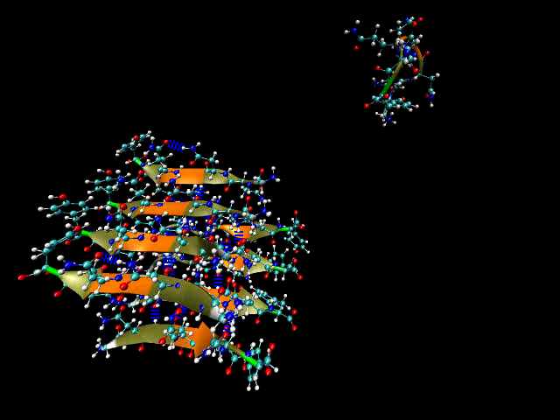
Sustained Performance of Parallel System
(MDGRAPE-3)
Gordon Bell 2006 Honorable Mention, Peak Performance
Amyloid forming process of Yeast Sup 35 peptides
Systems with 17 million atoms
Cutoff simulations (Rcut = 45 Å)
0.55sec/step
Sustained performance:
185 Tflops
Efficiency ~ 45 %
~million atoms necessary
for petascale

Slide 14
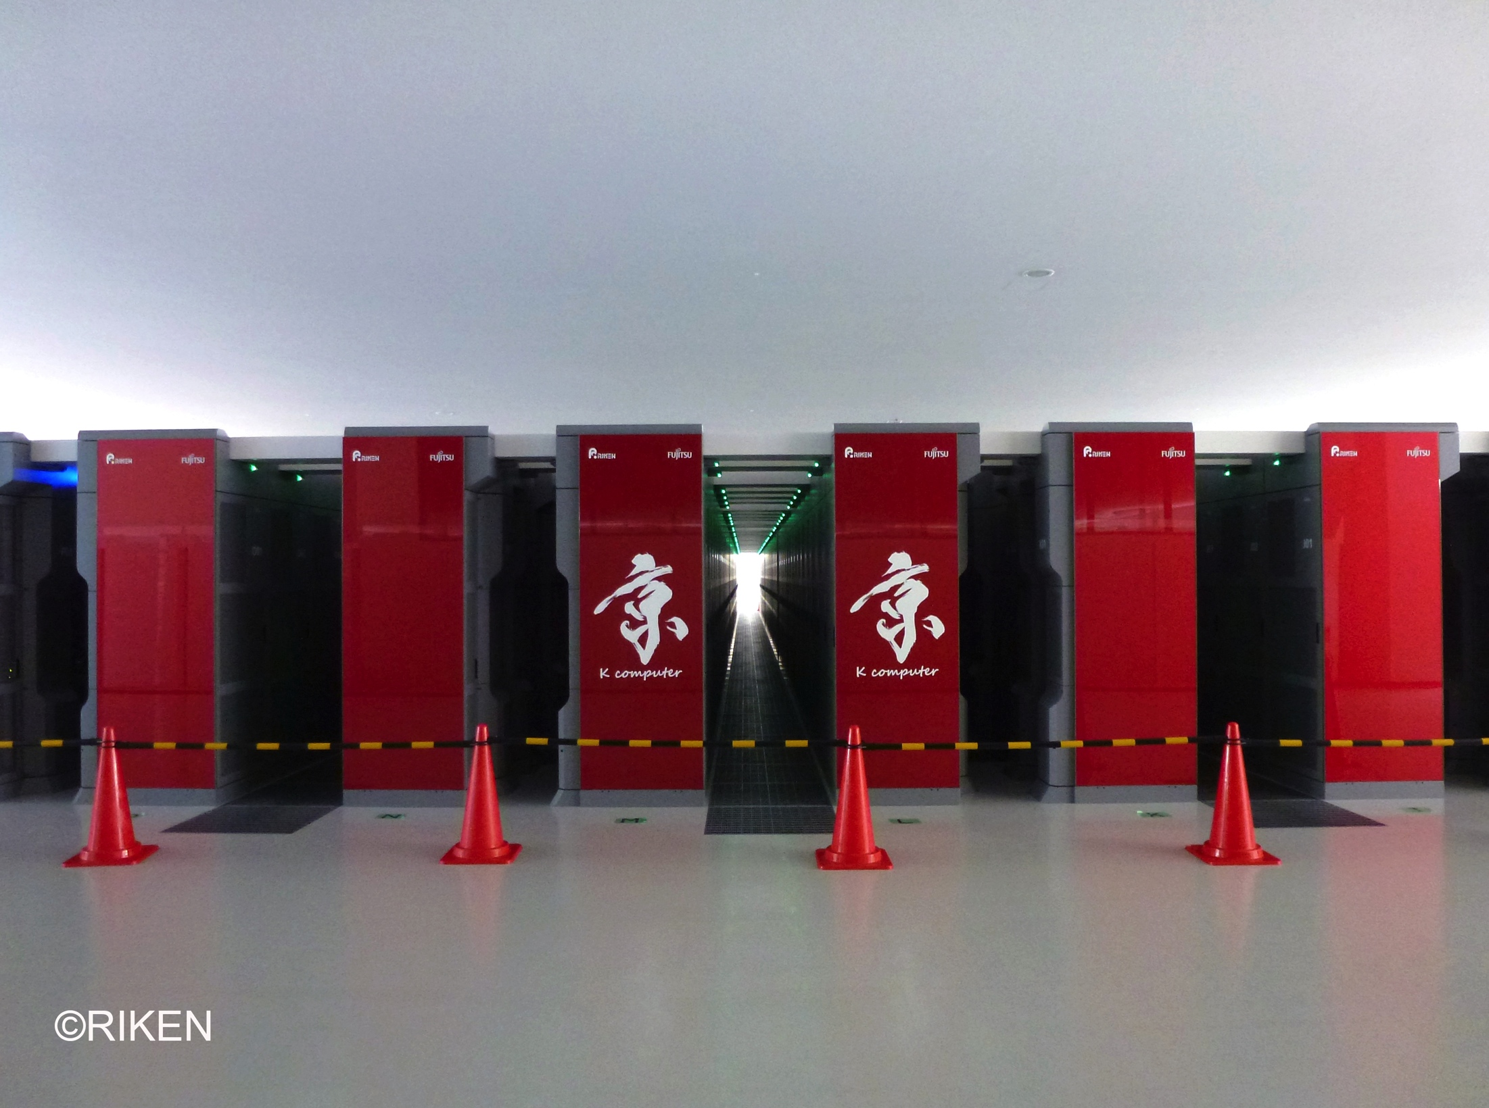

Scaling of MD on K Computer
Strong scaling
〜50 atoms/core
~3M atoms/Pflops
1,674,828
atoms
Since K Computer is still under development,
the result shown here is tentative.

Slide 15
Problem in Heterogeneous System - GRAPE/GPUs
In small system
  Good acceleration, High performance/cost
In massively-parallel system
  Scaling is often limited by host-host network, host-accelerator interface
Typical Accelerator System
SoC-based System

Slide 16
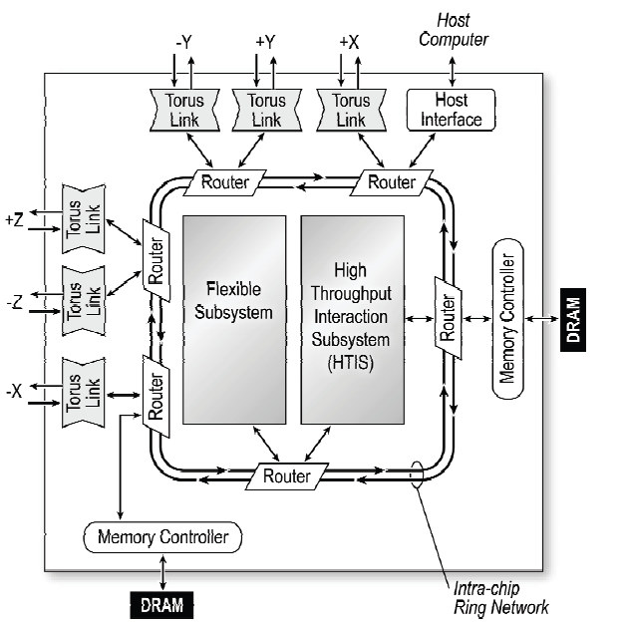
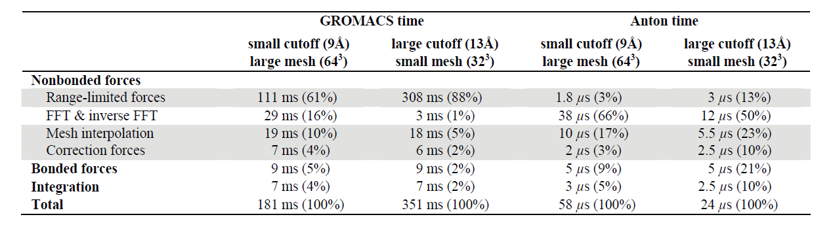
Anton
D. E. Shaw Research
Special-purpose pipeline
+ General-purpose CPU core
+ Specialized network
Anton showed the importance of the optimization in communication system
R. O. Dror et al., Proc. Supercomputing 2009, in USB memory.

Slide 17
MDGRAPE-4
Special-purpose computer for MD simulation
Test platform for special-purpose machine
Target performance
  10μsec/step for 100K atom system
    At this moment it seems difficult to achieve…
  8.6μsec/day (1fsec/step)
Target application : GROMACS
Completion: ~2013
Enhancement from MDGRAPE-3
  130nm → 40nm process
  Integration of Network / CPU
The design of the SoC is not finished yet, so we cannot report performance estimation.

Slide 18
MDGRAPE-4 System
MDGRAPE-4
SoC
Total 512 chips
(8x8x8)
12 lane
6Gbps
Electric
= 7.2GB/s
(after 8B10B
encoding)
48 Optical
Fibers
Node
(2U Box)
Total 64 Nodes
(4x4x4)
=4 pedestals
12 lane
6Gbps
Optical

Slide 19
MDGRAPE-4 Node

Slide 20
MDGRAPE-4 System-on-Chip
40 nm (Hitachi), ~ 230mm²
64 force calculation pipelines
@ 0.8GHz
64 general-purpose processors
Tensilica Extensa LX4
@0.6GHz
72 lane SERDES @6GHz

Slide 21
SoC Block Diagram

Slide 22
Embedded Global Memories in SoC
2 Pipeline
Blocks
~1.8MB
4 Block
For Each Block
  128bit X 2 for General-purpose core
  192bit X 2 for Pipeline
  64 bit X 6 for Network
  256bit X 2 for Inter-block
Network
2 GP
Blocks
GM4 Block
460KB
GM4 Block
460KB
GM4 Block
460KB
GM4 Block
460KB

Slide 23

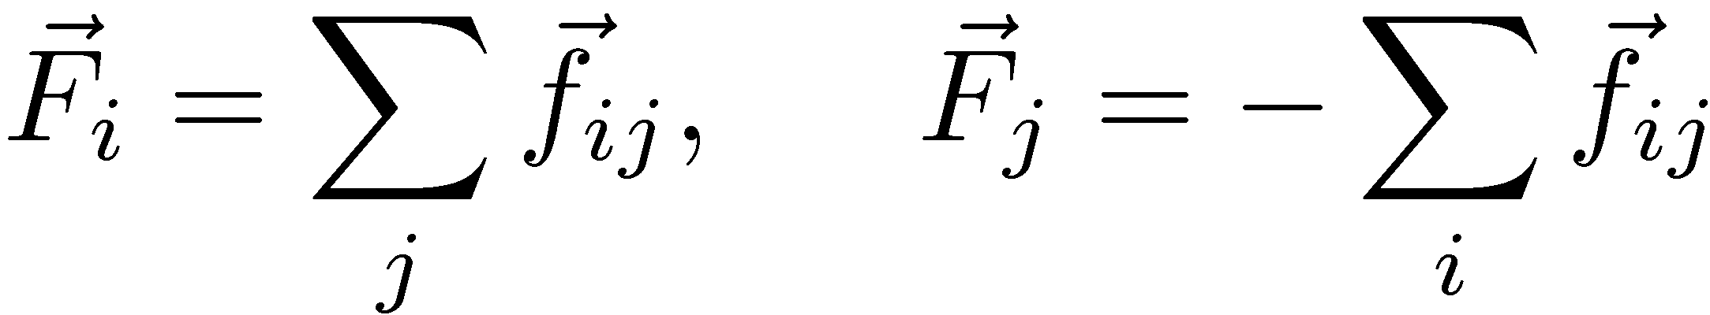
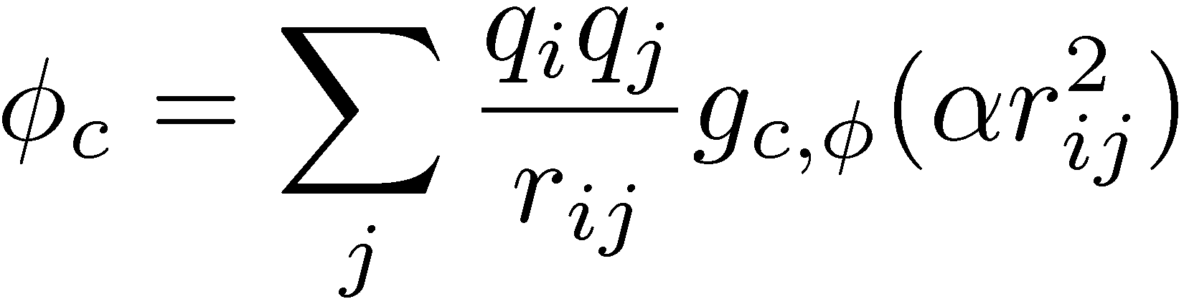

Pipeline Functions
Nonbond forces
and potentials
Gaussian charge assignment & back interpolation
Soft-core

Slide 24
Pipeline Block Diagram
~28 stages

Slide 25
Pipeline speed
Tentative performance
  8x8 pipelines @0.8GHz(worst case)
  64x0.8=51.2 G interactions/sec
  512 chips = 26 T interactions/sec
  Lcell=Rc=12A, Half-shell ..2400 atoms
  10⁵ X 2400/ 26T ~ 9.2 μsec
  Flops count ~50 operations / pipeline
  2.56 Tflops/chip

Slide 26
General-Purpose Core
Core
Tensilica LX @ 0.6 GHz
32bit integer / 32bit Floating
4KB I-cache / 4KB D-cache
8KB Local Memory
  DMA or PIF access
8KB Local Instruction Memory
  DMA read from 512KB Instruction memory
4KB
Dcache
8KB
D-ram
Core
Integer
Queue
Floating
4KB
Icache
8KB
I-ram
GP Block
Instruction
Memory
Inst-ruction
DMAC
Core
Core
Core
Core
DMAC
Global
Memory
PIF
Barrier
Core
Core
Core
Core
Control
Processor
Queue IF

Slide 27
Synchronization
8-core synchronization unit
Tensilica Queue-based synchronization
send messages
  Pipeline → Control GP
  Network IF → Control GP
  GP Block → Control GP
Synchronization at memory
– accumulation at memory

Slide 28
Network Latency
Current latency
~ 400 ns
Kick network interface
→ Read global memory
→ Finish transaction of 512B packet
to the nearest chip’s global memory
Latency in optical modules is not included
Larger than we anticipated…

Slide 29
Power Dissipation (Tentative)
Dynamic Power (Worst) < 40W
  Pipeline ~ 50%
  General-purpose core ~ 17%
  Others ~ 33%
Static (Leakage) Power
  Typical ~5W, Worst ~30W
~ 50 Gflops/W
  Low precision
  Highly-parallel operation at modest speed
  Energy for data movement is small in pipeline

Slide 30
Cost
Development (including the first system)
  ~ 9M$
Reproduction
  2.5 ~ 3M$ (Not sales price)
    0.6~1M$ SoC
    ~1M$ Optical components
    0.8~1M$ Other parts
    ~0.1M$ Host computer

Slide 31
Schedule
First signoff ~ 2012 July
Chip delivery ~ 2H 2012
System ~ 1H 2013
SDK ~ 2H 2012
Software ~ 1H 2014
Collaborators welcome!

Slide 32
Reflection
Though the design is not finished yet…
Latency in Memory Subsystem
  More distribution inside SoC
Latency in Network
  More intelligent Network controller
Pipeline / General-purpose balance
  Shift for general-purpose?
  # of Control GP

Slide 33
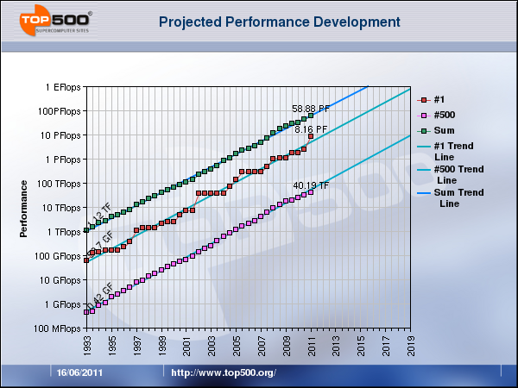
What happens in future?
Exaflops
@2019

Slide 34
Merit of specialization（Repeat）
Low frequency / Highly parallel
Low cost for data movement
  Dedicated pipelines, for example
Dark silicon problem
  All transistors cannot be operated simultaneously
  due to power limitation
  Advantages of dedicated approach:
    High power-efficiency
    Little damage to general-purpose performance

Slide 35
Future Perspectives (1)
In life science fields
  High computing demand, but
  we do not have so many applications that scale to exaflops (even petascale is difficult)
Requirement for strong scaling
  Molecular Dynamics
  Quantum Chemistry (QM-MM)
  There remain problems to be solved in petascale

Slide 36
Future Perspectives (2)
For Molecular Dynamics
Single-chip system
  >1/10 of the MDGRAPE-4 system can be embedded with 11nm process
  For typical simulation system it will be the most convenient
  Still network is necessary inside SoC
For further strong scaling
  # of operations / step / 20Katom ~ 10⁹
  # of arithmetic units in system ~ 10⁶ /Pflops
  Exascale means “Flash” (one-path) calculation
  More specialization is required

Slide 37
Acknowledgements
RIKEN
  Mr. Itta Ohmura
  Dr. Gentaro Morimoto
  Dr. Yousuke Ohno
Hitachi Co. Ltd.
Mr. Iwao Yamazaki
Mr. Tetsuya Fukuoka
Mr. Makio Uchida
Mr. Toru Kobayashi
and many other staffs
Hitachi JTE Co. Ltd.
Mr. Satoru Inazawa
Mr. Takeshi Ohminato
Japan IBM Service
  Mr. Ken Namura
  Mr. Mitsuru Sugimoto
  Mr. Masaya Mori
  Mr. Tsubasa Saitoh

