Slide 1
AICS Café – 2013/01/18
AICS System Software team
Akio SHIMADA

Slide 3
Outline
Self-introduction
Introduction of my research
  PGAS Intra-node Communication towards Many-Core Architectures (The 6th Conference on Partitioned Global Address Space Programming Models, Oct. 10-12, 2012, Santa Barbara, CA, USA)

Slide 4
Self-introduction
Biography
  AICS RIKEN System software team (2012 - ?)
    Research and develop the many-core OS
      Key word: many-core architecture, OS kernel, process / thread management
  Hitachi Yokohama Laboratory(2008 – present)
    in Dept. of the storage product
      Research and develop the file server OS
      Key word: Linux, file system, memory management, fault tolerant
  Keio university (2002 – 2008)
    Obtained my Master’s degree in Dept. of the Computer Science
      Key word: OS kernel, P2P network, secutiry

Slide 5
Hobby
  Cooking
  Football

Slide 6
PGAS Intra-node Communication towards Many-Core Architecture
Akio Shimada, Balazs Gerofi, Atushi Hori
and Yutaka Ishikawa
System Software Research Team
Advanced Institute for Computational Science
RIKEN
Notes:
Hello everyone, I’m Akio Shimada from RIKEN, Japan.
Today, I talk about PGAS Intra-node Communication towards Many-Core Architecture.
Let me give a presentation.

Slide 7
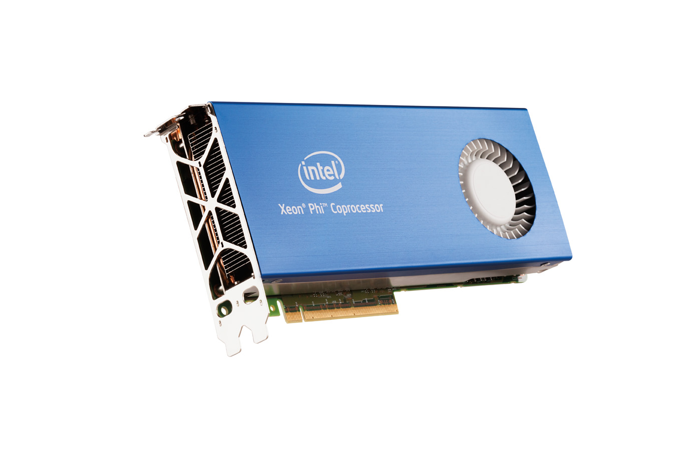
Background 1: Many-Core Architecture
Many-Core architectures are gathering attention towards Exa-scale super computing
  Several tens or around an hundred cores
  The amount of the main memory is relatively small
Requirement in the many-core environment
  The intra-node communication should be faster
    The frequency of the intra-node communication can be higher due to the growth of the number of cores
  The system software should not consume
  a lot of memory
    The amount of the main memory per core
    can be smaller
Notes:
First, I talk about the background of this research.
Many-core architectures which has several ten or a few hundred cores are gathering attention towards Exa-scale super computing.
Intra-node parallelization will be important issue in many-core environment because the number of cores per node grow more and more.
----- 会議メモ (12/10/04 16:55) -----
a few hundred cores → around hundred cores
Intra-node para… The intranode
イントラノード通信を早くしなくちゃいけないと書く
メモリの消費量は少なくすると書く

Slide 8
Background 2: PGAS Programming Model
Partitioned global array is distributed onto the parallel processes
Process 0
Process 1
Process 2
Process 3
Process 4
Process 5
array
[0:9]
array
[10:19]
array
[20:29]
array
[30:39]
array
[40:49]
array
[50:59]
Core 0
Core 1
Core 0
Core 1
Core 0
Core 1
Node 0
Node 1
Node 2
Intra-node（ ） or Inter-node（ ） communication takes place when accessing the remote part of the global array
Notes:
On the other hand, It is becoming common to build parallel applications utilizing PGAS programming model.
Several PGAS languages, such as UPC, X10 or XcalableMP are so far proposed.
PGAS supports data access locality performance advantage of message passing programing model.
On PGAS, Global array is …….
And each process access its local part of the global array for computation.
Then PGAS supports data referencing simplicity of shared memory programming model.
An access to the local ……….
Simple programming ……….
----- 会議メモ (12/10/04 16:55) -----
supportsなんたらは意味がない → PGAS programming model
automaticallyはいらない
access → accesses
図で書く

Slide 9
Research Theme
This research focuses on PGAS intra-node communication on the many-core architectures
Process 0
Process 1
Process 2
Process 3
Process 4
Process 5
array
[0:9]
array
[10:19]
array
[20:29]
array
[30:39]
array
[40:49]
array
[50:59]
Core 0
Core 1
Core 0
Core 1
Core 0
Core 1
Node 0
Node 1
Node 2
As mentioned before, the performance of the intra-node communication is an important issue on the many-core architectures

Slide 10
Problems of the PGAS Intra-node Communication
The conventional schemes for the intra-node communication are costly on the many-core architectures
There are two conventional schemes
  Memory copy via shared memory
    High latency
  Shared memory mapping
    Large memory footprint in the kernel space
Notes:
----- 会議メモ (12/10/04 16:55) -----
下線は消す

Slide 11
Memory Copy via Shared Memory
Virtual Address Space
of Process 1
Virtual Address Space
of Process 2
Physical Memory
Local Array
[0:49]
Local Array
[50:99]
Write Data
Write Data
Memory Copy
Memory Copy
Shared Memory Region
Write Data
Write Data
Write Data
This scheme utilizes a shared memory as an intermediate buffer
  It results in high latency due to two memory copies
The negative impact of the latency is very high in the many-core environment
  The frequency of the intra-node communication can be due to the growth of the number of cores
Notes:
Memory copy via shred memory scheme utilizes the shred memory as an intermediate buffer.
On this strategy, intra-node communication take place by memory copy via a shared memory as described in this figure.
It results in high latency due to two memory copies. memory copy from send-buffer to shared memory and memory copy from shred memory to recv-buffer
The negative impact of ……….
----- 会議メモ (12/10/04 16:55) -----
highはいらない
frequencyはhigh
many-core environmentいいすぎ

Slide 12
Shared Memory Mapping
Virtual Address Space
of Process 1
Virtual Address Space
of Process 2
Physical Memory
Local Array
[0:49]
Shared Memory Region for
Array [0:49]
Remote Array
[0:49]
Write Data
Remote Array
[50:99]
Shared Memory Region for
Array [50:99]
Local Array
[50:99]
Memory Copy
Write Data
Write Data
Write Data
・・・
・・・
・・・
Each process designates a shared memory as a local part of the global array and all other processes map this region to their own address space
  Intra-node communication produce just one memory copy (low latency)
  The cost of mapping shared memory regions is very high
Notes:
Next, I explain shared memory mapping scheme.
On this scheme, each process designates …….
Access to the remote part of the global array can be accomplished simply using just one memory copy to or from the local address region, which maps the remote array.
So its access speed is very high.
However, this strategy results in excessive numbers of memory footprints in the kernel space because the shared mapped memory regions must be memory-mapped to all processes.
Since there are n shared memory regions because each process has its own region, in situations where n is the number of cores,
O(n2) page table entries will be required.

Slide 13
Linux Page Table Architecture on X86-64
pgd
pud
pmd
pte
page
(4KB)
・・・
up to
2MB
・・・・・・
・・・・・・
・・・・・・
page
(4KB)
pte
page
(4KB)
pmd
pud
・・・
page
(4KB)
4KB page table can map 2MB of physical memory
O(n²) page tables are required on “shared memory mapping scheme”, where n is the number of cores (processes)
  All n processes map n arrays in their own address spaces
  (n² × (array size ÷ 2MB)) page tables are totally required
Total size of the page tables is 20 times the size of the array, where n=100
  100² x array size ÷ 2MB x 4KB = 20 x array size
  2GB of the main memory is consumed, where the array size is 100MB !
Notes:
This is the architecture of the x86 64bit page table.
x86 supports four-level page table.
one page table which size is 4KB can map 2MB memory region.
For example, 200MB memory is required for page table space, where the number of process is 100 and each process has 10MB array.
----- 会議メモ (12/10/04 16:55) -----
nが100の時は、アレイサイズの20倍がページテーブルに使われる
最後の行はいらない

Slide 14
Goal & Approach
Goal
  Low cost PGAS intra-node communication on the many-core architectures
    Low latency
    Small memory footprint in the kernel space
Approach
  Eliminating address space boundary between the parallel executed processes
    It is thought that the address space boundary produces the cost for the intra-node communication
      two memory copies via shared memory or memory consumption for mapping shared memory regions
  It enables parallel processes to communicate with each other without costly shared memory scheme
Notes:
Now I explain the concept of this research.
The purpose of this research is to enable low cost PGAS intra-node communication in may core environments.
Proposed intra-node communication enables low latency and fewer memory footprints in kernel space.
The Approach is below.
It is thought that address space boundary between the parallel processes produces intra-node communication cost.
Because address spaces are separate for each process, overcoming the address space boundaries require either multiple data copies between each process engaged in sharing, or mapping shared memories to each separate address space.
Conversely, if there are no address space boundaries between the processes, it is possible to achieve low cost intra-node communication.
----- 会議メモ (12/10/04 16:55) -----
2行にわける（コストのところ）

Slide 15
Partitioned Virtual Address Space (PVAS)
A new process model enabling low cost intra-node communication
Process 0
PVAS Address Space
TEXT
PVAS
Process 0
PVAS
Segment
DATA&BSS
Virtual Address
Space
HEAP
Virtual Address Space
STACK
PVAS
Process 1
KERNEL
Process 1
PVAS
Process 2
TEXT
DATA&BSS
・・・
Virtual Address
Space
HEAP
STACK
KERNEL
KERNEL
Running parallel processes in a same virtual address space without process boundaries (address space boundaries)
Notes:
Then, we propose partitioned virtual address space which is new process model enabling low cost intra-node communication.
We call this process model “PVAS”.
This figure describes normal process model on linux and our PVAS process model.
Left one is the semantics view of the virtual address space on the normal process model.
On normal process model, each process has its own address space and there are address space boundary between multiple processes.
Then, intra-node communication take place utilizing shared memory scheme which introduce high communication cost to overcome address space boundary.
In contrast, on PVAS process model, multiple process runs in a same virtual address space that is partitioned but not separated as described in this figure.
Since there are no address space boundary between the processes, each process can access to the data of the other processes directly.
So the access speed is very high and there is no need for mapping shared memory region which introduce extra memory footprints in kernel space,
On this process model, processes don’t have to map the remote part of the global array in their own address space,
so only o(n) page tables required.
----- 会議メモ (12/10/04 16:55) -----
without process boundary

Slide 16
Terms
PVAS Process
  A process running on the PVAS process model
  Each PVAS process has its own PVAS ID assigned by the parent process
PVAS Address Space
  A virtual address space where parallel processes run
PVAS Segment
  Partitioned address space assigned to each process
  Fixed size
  Location of the PVAS segment assigned to the PVAS process is determined by its PVAS ID
    start address = PVAS ID × PVAS segment size
PVAS Address Space
(segment size = 4GB)
0x10000000
PVAS Process 1
(PVAS ID = 1)
PVAS
segment 1
0x20000000
PVAS Process 2
(PVAS ID = 2)
PVAS
segment 2
・・・・・
Notes:
Then I explain some specification of PVAS.
PVAS process is ………
PVAS address space sis ………
PVAS Segment is ……
----- 会議メモ (12/10/04 16:55) -----
specification → terms
that → where
paralle → PVAS
partitioned "PVAS" address space

Slide 17
Intra-node Communication of PVAS (1)
Access to the remote array
  An access to the remote array is simply done by the load and store instructions as well as an access to the local array
Remote address calculation
  Static data
    remote address =
    local address +
    (remote ID – local ID) ×
    segment size
  Dynamic data
    Export segment is located on top of each PVAS segment
    Each process can exchange the information for the intra-node communication to read and write the address of the shared data to/from the export segment
char array[]
PVAS segment
for process 1
・・・
+ (1-5) × PVAS segment size
char array[]
PVAS segment
for process 5
PVAS Segment
Low
EXPORT
Address
TEXT
DATA&BSS
HEAP
High
STACK
Notes:
On PVAS process model, Each process can …….
On PVAS, Remote Address calculation is very simple.
In case of static data, remote address = …….
In case of dynamic data, programmer can use export segment which is located on top of each PVAS segment.
Each process can …….

Slide 18
Intra-node Communication of PVAS (2)
Performance
  The performance of the intra-node communication of the PVAS is comparable with that of “shared memory mapping”
  Both intra-node communication produce just one memory copy
Memory footprint in the kernel space
  The total number of the page tables required for the intra-node communication of PVAS can be fewer than that of “shared memory mapping”
  Only O(n) page tables are required since one process maps only one array

Slide 19
Evaluation
Implementation
  PVAS is implemented in the kernel of Linux version 2.6.32
  Implementation of the XcalableMP coarray function is modified to use PVAS intra-node communication
    XcalableMP is an extended language of C or Fortran, which supports PGAS programming model
    XcalableMP supports coarray function
Benchmark
  Simple ping-pong benchmark
  NAS Parallel Benchmarks
Evaluation Environment
  Intel Xeon X5670 2.93 GHz (6 cores) × 2 Sockets
Notes:
Then we evaluated PVAS using some bench mark program.
To evaluate PVAS, we implemented PVAS in the kernel of Linux version 2.6.32.
And Coarray function of the XcalableMP is modified to use PVAS feature as lverage for the intra-node communication
XcalableMP is one of the PGAS language.
We evaluate PVAS using simple ping-pongbech mark and NAS parallel benchmarks which is implemented by coarray of XcalableMP.
This evaluation was performed in a multi-core environment because the targeted many-core have yet to be released.
Here, it is assumed that our multicore environment test results would match those obtained from those unreleased many-core environments because (except for
core numbers) multi- and many-core architecture is basically the same.

Slide 20
XcalableMP Coarray
Coarray is declared by xmp coarray pragma
The remote coarray is represented as the array expression attached
:[dest_node] qualifier
Intra-node communication takes place when accessing the remote coarray located on the intra-node process
・・・
#include <xmp.h>
char buff[BUFF_SIZE];
char local_buff[BUFF_SIZE];
#pragma xmp nodes p(2)
#pragma xmp coarray buff:[*]
int main(argc, *argv[]) {
int my_rank, dest_rank;
my_rank = xmp_node_num();
dest_rank = 1 – my_rank;
local_buff[0:BUFF_SIZE] = buff[0:BUFF_SIZE]:[dest_rank];
return 0;
}
Sample code of the XcalableMP coarray
Notes:
Then, I explain the coarray of xcalableMP.
This is the sample code of coarray of XcalableMP.
In this sample program, a pair of process copy the data of the remote coarray to their own local buffer with each other.
An access to the …….
Intra-node communication …….

Slide 21
Modification to the Implementation of the XcalableMP Coarray
XcalableMP coarray utilizes GASNet PUT/GET operations for the intra-node communication
  GASNet can employ two schemes as mentioned before
    GASNet-AM ： “Memory copy via shared memory”
    GASNET-Shmem： “Shared memory mapping”
Implementation of the XcalableMP coarray is modified to utilize PVAS intra-node communication
  Each process writes the address of the local coarray in its own export segment
  Processes access the remote coarray confirming the address written in export segment of destination process
Notes:
Next, I explain a modification to XcalableMP we performed.
XcalableMP utilizes …….
XcalableMP is …….
----- 会議メモ (12/10/04 16:55) -----
operations
as mentioned before

Slide 22
Ping-pong Communication
Measured Communication
  A pair of process write data to the remote coarrays with each other according to the ping-pong protocol
Performance was measured with these intra-node communications
  GASNet-AM
  GASNet-Shmem
  PVAS
The performance of PVAS was comparable with GASNet-Shmem
Notes:
First we evaluated PVAS on simple ping-poing communication benchmark.
On this benchmark, a pair of process write data to the remote coarray with each other according to the ping-pong protocol and its communication latency and bandwidth are measured.
Performance was measured with these intra-node communications:
First is GASNet-AM that utilizes memory copy via shared memory scheme
Secondi is GASNET-Shmem that utilizes shared memory mapping scheme
Third is PVAS
The performance of PVAS was …….

Slide 23
NAS Parallel Benchmarks
The performance of the NAS Parallel Benchmarks implemented by the XcalableMP coarray was measured
Conjugate gradient (CG) and integer sort (IS) benchmarks are performed (NP=8)
CG benchmark
IS benchmark
The performance of PVAS was comparable with GASNet-Shmem

Slide 24
Evaluation Result
The performance of the PVAS is comparable with GASNet-Shmem
  Both of them produce only one memory copy for the intra-node communication
  However, memory consumption for the intra-node communication of the PVAS can be in theory smaller than that of GASNet-shmem
    Only O(n) page tables are required on the PVAS, in contrast, O(n²) page tables are required on the
    GASNet-Shmem

Slide 25
Related Work (1)
SMARTMAP
  SMARTMAP enables a process for mapping the memory of another process into its virtual address space as a global address space region.
  O(n²) problem is avoided since parallel processes share the page tables mapping the global address space
  Implementation is depending on x86 architecture
    The first entry of the first-level page table, which maps the local address space, is copied onto the another process’s first-level page table
Local Address
Space
Global Address Space
Address space of the four processes on SMARTMAP
Notes:
----- 会議メモ (12/10/04 16:55) -----
not effective → avoided
SMARTMAPをもっとちゃんと説明する

Slide 26
Related Work (2)
KNEM
  Message transmission between two processes takes place via one memory copy by the kernel thread
  Kernel-level copy is more costly than user-level copy
XPMEM
  XPMEM enables processes to export its memory region to the other processes
  O(n²) problem is effective

Slide 27
Conclusion and Future Work
Conclusion
  PVAS process model which enhances PGAS intra-node communication was proposed
    Low latency
    Small memory footprint in the kernel space
  PVAS eliminates address space boundaries between processes
  Evaluation results show that PVAS enables high-performance intra-node communication
Future Work
  Implementing PVAS as Linux kernel module to enhance portability
  Implementing MPI library which utilizes the intra-node communication of the PVAS
Notes:
Finally we introduce conclusion and future work.
----- 会議メモ (12/10/04 17:12) -----
PVASという名詞を出す
もっとPVASのいいところをちゃんと書く
MPIでも使えると書く（Future Work）

Slide 28
Huge Page
pgd
pud
pmd/pte
page
(2MB)
・・・
up to
1GB
page
(2MB)
4KB page table can map 1GB of physical memory
  O(n²) problem is still effective where array size is over 1GB
In case that array size is not aligned on the 2MB boundary, unnecessary memory consumption is produced

